Slide 1



Road Accident Dashboard
View in Power BI
Last data refresh:
2/1/2026 3:07:40 AM UTC
Downloaded at:
2/1/2026 3:14:05 AM UTC

Slide 2
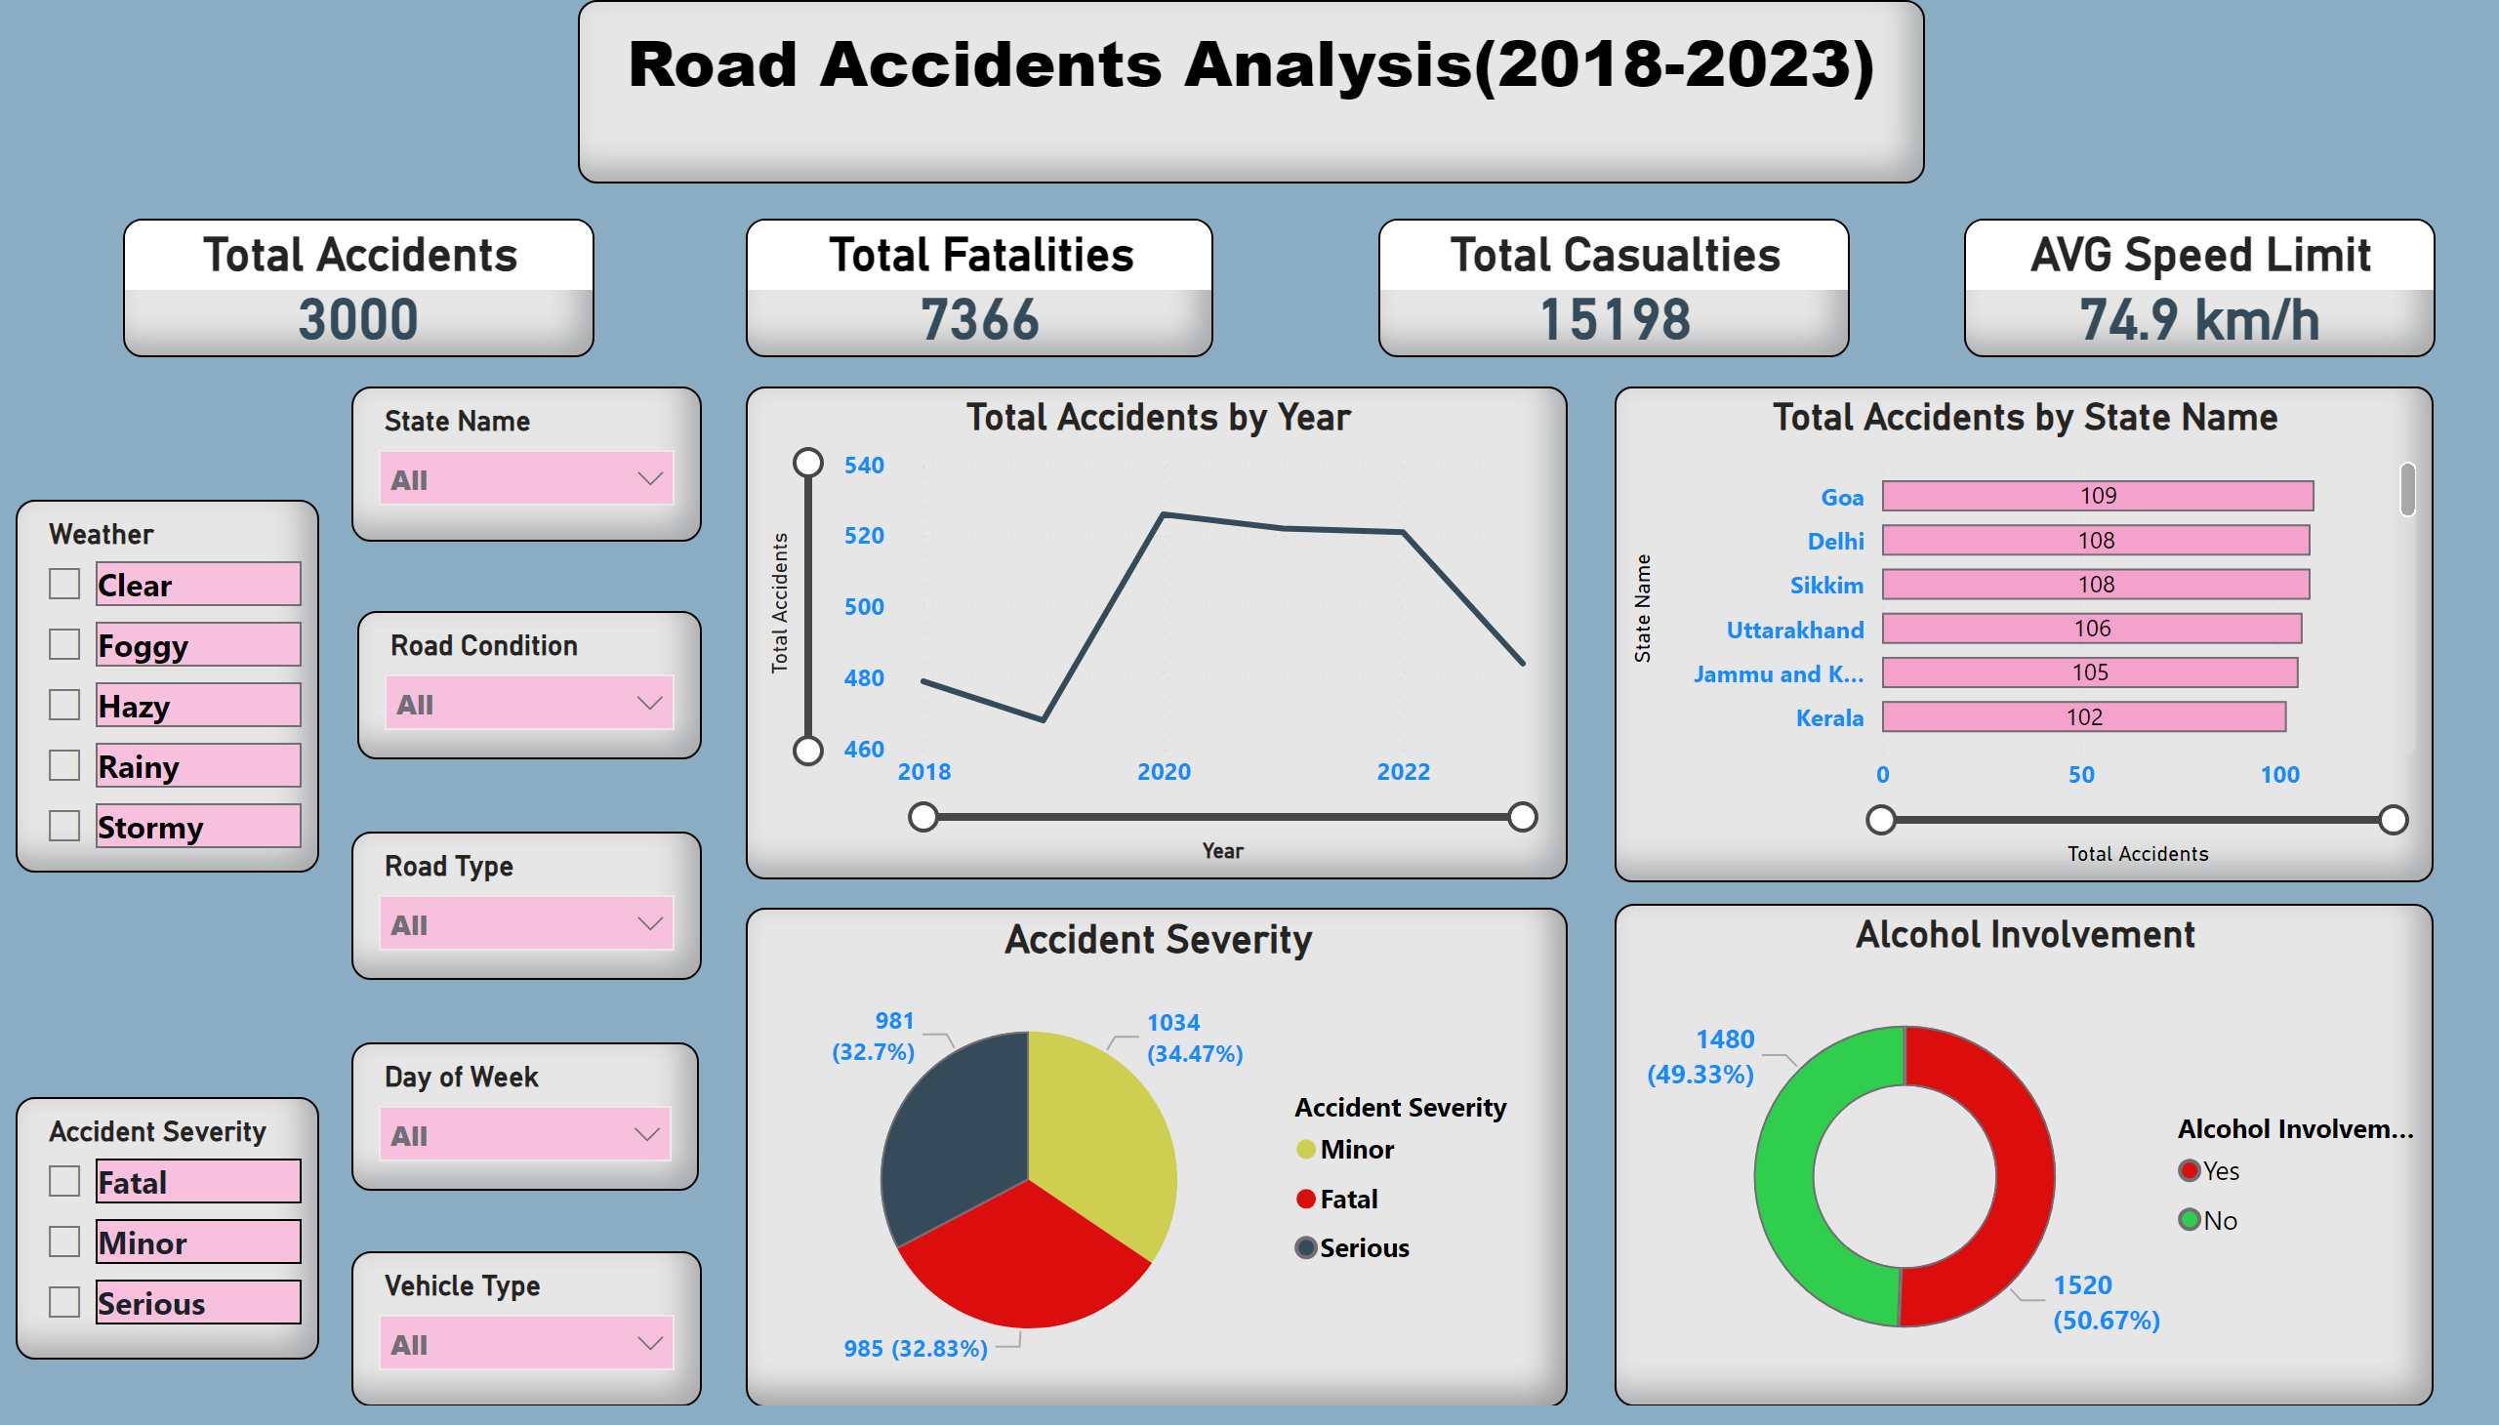
Dashboard
Notes:
textbox
No alt text provided
Total Accidents
No alt text provided
Total Fatalities
No alt text provided
Total Casualties
No alt text provided
AVG Speed Limit
No alt text provided
slicer
No alt text provided
slicer
No alt text provided
slicer
No alt text provided
slicer
No alt text provided
lineChart
No alt text provided
barChart
No alt text provided
Accident Severity
No alt text provided
Alcohol Involvement
No alt text provided
slicer
No alt text provided
slicer
No alt text provided
slicer
No alt text provided

